Slide 1
CAN-Measure
Session 3: Review Meeting
Thursday July 10, 2024 @1pm
Dr. Gord Boyd
Dr. Michelle Kho
Dr. Heather O’Grady

Slide 2
Agenda
Welcome & introductions
Overview of remainder of course
Reflection: how has practice been going?
Review of outcome measures
Practice with instructor feedback
Curveballs
Q&A
Intro to competencies
Summary & next steps
Feedback questionnaire

Slide 3
Introductions
What is your name?
What is your role in research?
What is your favourite animal?

Slide 4
Overview of Training Approach
Timepoint 1 (1hr x 2)
1-hour virtual training session per measure (2 hours total)
Timepoint 2 (1.5hr)
Practice FAQs
Introduce competencies
Timepoint 3 (1hr)
Evaluation of outcome assessors
1 month
1 month

Slide 5
Today’s Objective: Discuss outcome measures, potential challenges/obstacles and introduce competencies

Slide 6
How has your experience been practicing the measures?

Slide 7
Review of Outcome Measures

Slide 8
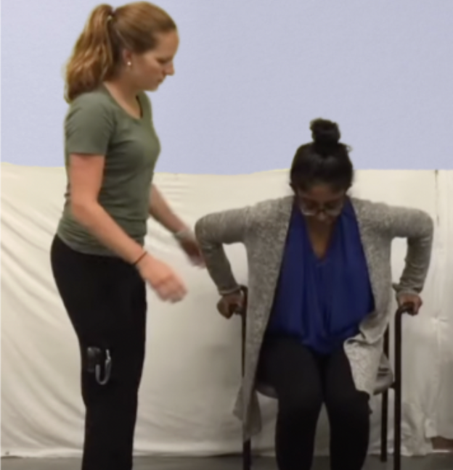
30 second sit-to-stand (30s STS)
Performance-based assessment of physical function/ exercise capacity
Scoring: number of successful STS repetitions completed in 30 seconds
Normative values available for specific age groups
Administration time: less than 5 minutes

Slide 9
Set-Up
Materials:
Chair with arm rests or bed
Stopwatch
Additional person to help with test administration
Participant:
Feet on the floor, approximately hip-width apart
One foot slightly in front of the other
Arms crossed across the chest, if possible

Slide 10
Administration
Individuals may use a gait aid and/or as much assistance as needed to safely stand
Individuals may push off arm rests if needed
Individuals must stand up and sit all the way back down for each repetition to count
If the individual is more than halfway up at the end of 30 seconds, count this as a full stand

Slide 11
The Repeatable Battery for the Assessment of Neuropsychological Status (RBANS)
Patient-reported cognitive assessment
5 domains:
Immediate memory
Delayed memory
Visuospatial
Language
Executive function
Scoring: sum score reflects overall cognition
Administration time: approximately 30 minutes
Administration: standardized in testing booklets

Slide 12
You try!
We will have 20 minutes for practice – you will enter a breakout room to practice with instructor feedback for 2 to 5 minutes per outcome measure.

Slide 13
Scenarios

Slide 14
Scenario 1: You approach an individual to conduct an outcome measure assessment. They ask you why they should do the test.
What would you say?
Outcome measures allow us to explore the effects of different treatments (in a research setting) and to track your progress and recovery.
Things to consider:
Participants may have a limited memory of their enrollment in research studies in the ICU.
For a specific study, you may need to briefly summarize the research study and its purpose.

Slide 15
Scenario 2: For the RBANS, if someone is getting frustrated and discouraged during the assessment, what should you do?
Our suggestion: Normalize the difficulty of the test. You may say things like “I administer this test a lot, and many people find this test hard and frustrating – just remember to try your best”

Slide 16
Scenario 3: You are performing an outcome measure assessment, and the participant says they want to stop the test.
What would you do?
Our suggestion: Encourage the participant to continue if they are able. If they persist/are unable, please stop the test.
For the 30s STS, let the timer run out to 30 seconds and score the number of repetitions completed.

Slide 17
Scenario 4: For the 30-second sit-to-stand, should you always have participants complete a practice repetition?
Our suggestion: You need to consider the patient’s baseline physical function. Patients may have limited reserve (e.g., patients at ICU d/c completed 5 reps and at hospital d/c completed 9 reps).
If a practice repetition may be helpful, please complete this with your participant.
If a practice session may compromise the ability of the participant to complete the test, it may not be appropriate to conduct.

Slide 18
Questions?

Slide 19
FAQs
Q1: Can you provide feedback to participants during the test?
A1: It depends! You can provide cueing to participants, but you should not be commenting on their performance during the assessment.
Q2: Does it matter what time of day you perform the assessment?
A2: Sometimes you may not have a choice of the timing (e.g., a participant in a follow-up clinic). However, if you can control the timing of the assessment, try to complete at a time when the individual is rested (e.g., did not just complete a physio session in hospital).
Q3: Should you always explain the test procedures? What do you say?
A3: Yes! Each test has a standardized set of instructions. Please use these!

Slide 20
Intro to Competencies

Slide 21
Overview of Competency Checklists
Used to evaluate, in a standardized way, the ability of outcome assessors to perform each outcome measure assessment
2 checklists (one per measure)
4 sections
Technical skills (30s STS or RBANS)
Communication (same for both measures)
Professionalism (same for both measures)
Overall performance (same for both measures)
Success Criteria: Overall performance of 5 on rating scale

Slide 22
Overview of Scoring

Slide 23
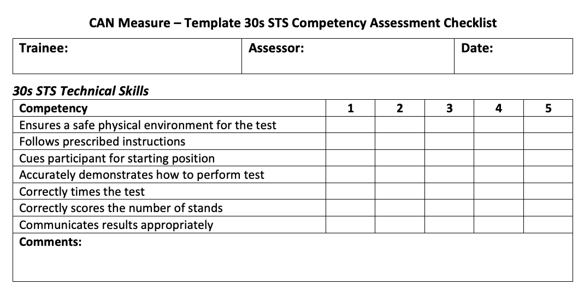
30s STS Technical Skills

Slide 24
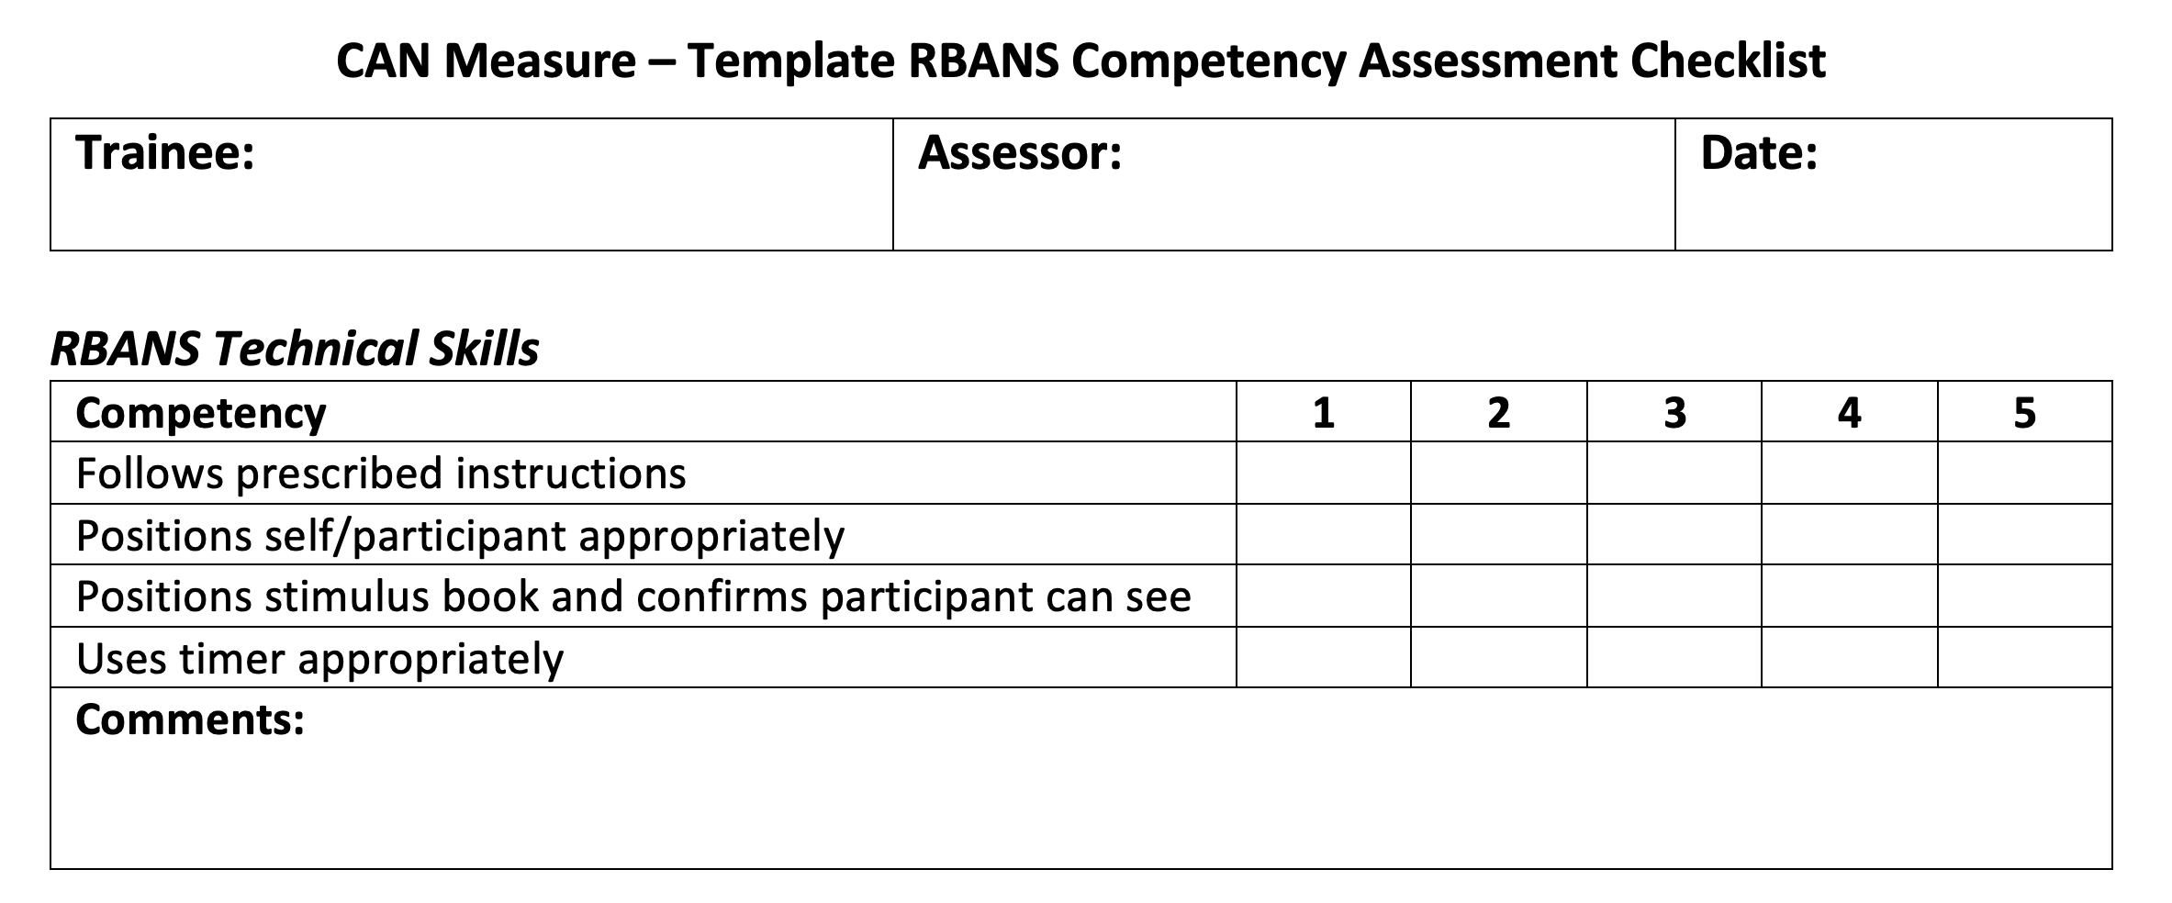
RBANS Technical Skills

Slide 25
Communication – Same for Both Measures

Slide 26
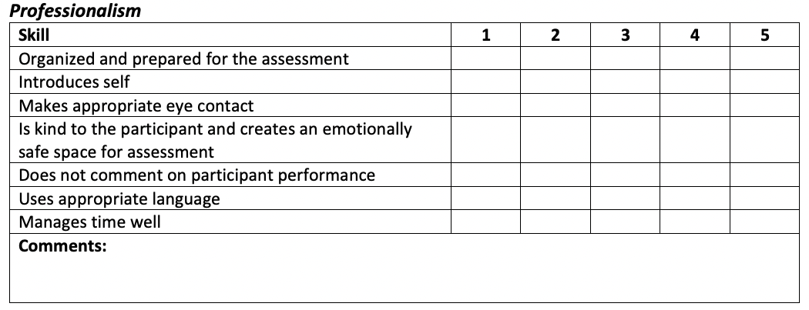
Professionalism & Overall – Same for Both Measures

Slide 27
Next Steps

Slide 28
Summary & Next Steps
Practice each measure with at least five different people
Complete your practice logbook
Book dates for your evaluation:
Aug 8th (Thursday) - from 12-6pm EST
Aug 23rd (Friday) - from 8-1pm EST

Slide 29
Feedback: Please use this time to complete feedback questionnaires if you have not already

Slide 30
Thank you!
Michelle: khome@mcmaster.ca Gord: 2gjb1@queensu.ca
Heather: ogradyh@mcmaster.ca

