Slide 1
CAN-Measure
Session 1:
RBANS Training
Wednesday, July 17, 2024 @ 3pm
Dr. Gord Boyd

Slide 2
Agenda
Welcome & introductions
Training overview
RBANS instructional video
Didactic instruction
Practice and feedback!
Scenarios
Questions & wrap-up

Slide 3
Introductions
What is your name?
What is your role in research?
What is your favourite place in the world?

Slide 4
Overview of Training Approach
Timepoint 1 (1hr x 2)
1-hour virtual training session per measure (2 hours total)
Timepoint 2 (1.5hr)
Practice FAQs
Introduce competencies
Timepoint 3 (1hr)
Evaluation of outcome assessors
1 month
1 month

Slide 5
Today’s Objective: Learn how to conduct the RBANS.

Slide 6
The Repeatable Battery for the Assessment of Neuropsychological Status (RBANS)
Patient-reported cognitive assessment
5 domains:
Immediate memory
Delayed memory
Visuospatial
Language
Executive function
Scoring: sum score reflects overall cognition
Administration time: approximately 30 minutes

Slide 7
RBANS Instructional Video

Slide 9
Set-Up

Slide 10
Administration

Slide 11
You try!
Take turns conducting the RBANS with each other.
We will provide feedback!

Slide 12
Scenarios

Slide 13
Scenario: “This is too hard…I give up!”
What would you do?

Slide 14
Scenario: “I don’t want to do this anymore!”
What would you do?

Slide 15
Questions?

Slide 16
Next Steps & Homework
Complete the RBANS with at least five different people
Complete your practice logbook
Attend 30s STS training (if not already done)
Book dates for your next sessions

Slide 17
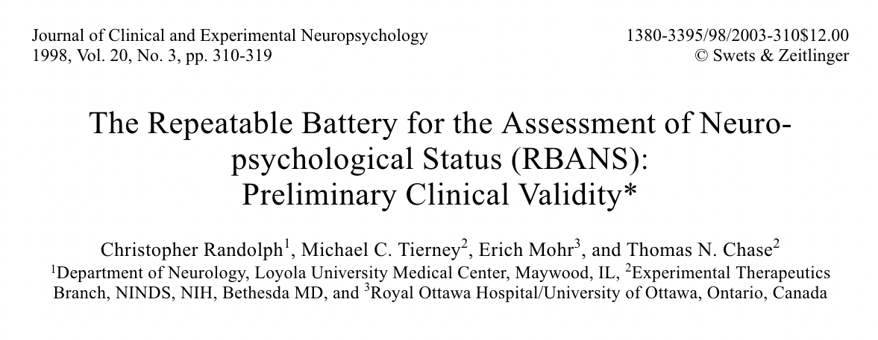
Resources
www.icucycle.com (log-in information to be sent after this meeting)

Slide 18
Thank you!
Gord: 2jgb1@queensu.ca
Heather: ogradyh@mcmaster.ca

