Slide 1
CAN-Measure
Session 1: 30s Sit-to-Stand Training
Wednesday, July 10th 2024 @3:15pm
Dr. Michelle Kho

Slide 2
Agenda
Welcome & introductions
Training overview
30s STS instructional video
Practice with peers
Didactic instruction
More practice and feedback!
Scenarios
Questions & wrap-up

Slide 3
Introductions
What is your name?
What is your role in research?
What is your favourite sunny-day activity?

Slide 4
Overview of Training Approach
Timepoint 1 (1hr x 2)
1-hour virtual training session per measure (2 hours total)
Timepoint 2 (1.5hr)
Practice FAQs
Introduce competencies
Timepoint 3 (1hr)
Evaluation of outcome assessors
1 month
1 month

Slide 5
Today’s Objective: Learn how to conduct and score the 30-second sit-to-stand test.

Slide 6
30s STS Instructional Video

Slide 7
Notes:
Pause at equipment section – confirm materials are available

Slide 8
You try!
Take turns conducting the 30s STS test with each other.
We are here if you have questions!
Notes:
Timer – embed for 10 minutes

Slide 9
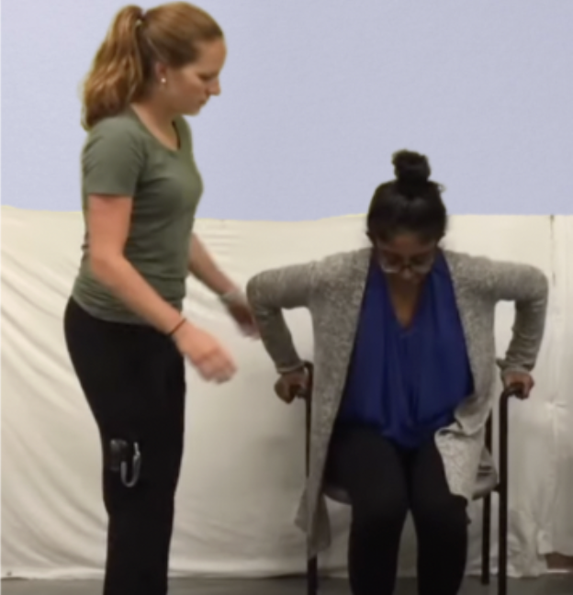
30 second sit-to-stand (30s STS)
Performance-based assessment of physical function/ exercise capacity
Scoring: number of successful STS repetitions completed in 30 seconds
Normative values available for specific age groups
Administration time: less than 5 minutes

Slide 10
Normative Values

Slide 11
Set-Up
Materials:
Chair with arm rests or bed
Stopwatch
Additional person to help with test administration
Participant:
Feet on the floor, approximately hip-width apart
One foot slightly in front of the other
Arms crossed across the chest, if possible

Slide 12
Administration
Individuals may use a gait aid and/or as much assistance as needed to safely stand
Individuals may push off arm rests if needed
Individuals must stand up and sit all the way back down for each repetition to count
If the individual is more than halfway up at the end of 30 seconds, count this as a full stand

Slide 13
Scoring
# of sit to stands completed
Level of assistance required
0 person assist
1 person assist
2 (or more) person assist
Location of STS test
Chair with arm rests (preferred)
Bed
Additional Safety and Documentation Considerations for Deconditioned Patients

Slide 14
You try!
Take turns conducting the 30s STS test with each other.
We will provide feedback!
Notes:
Timer – embed for 10 minutes

Slide 15
Scenarios

Slide 16
Scenario: You are performing the 30 second sit to stand test. You notice they are rushing and only standing up halfway with each repetition.
What would you do?
Stop the test as soon as you notice?
Cue the patient to stand fully for each repetition?
Re-start the test?

Slide 17
Scenario: Observe this person’s finishing position for this standing attempt.
Question 1: It is 25 seconds into the test. Will the individual receive full credit for standing?
Answer: No (the person must stand fully up)
Question 2: If this is the person’s finishing position at 30 seconds, will they receive full credit for standing?
Answer: Yes (if the person is more than halfway up when the test ends, you may count the stand repetition)

Slide 18
Questions?

Slide 19
Next Steps & Homework
Complete the sit to stand test with at least five different people
Complete your practice logbook
Attend RBANs training (if not already done)
Book dates for your next sessions

Slide 20
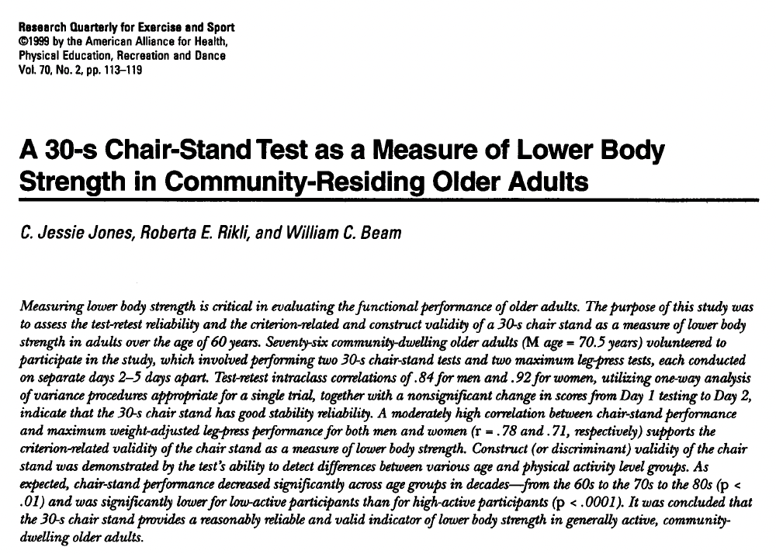
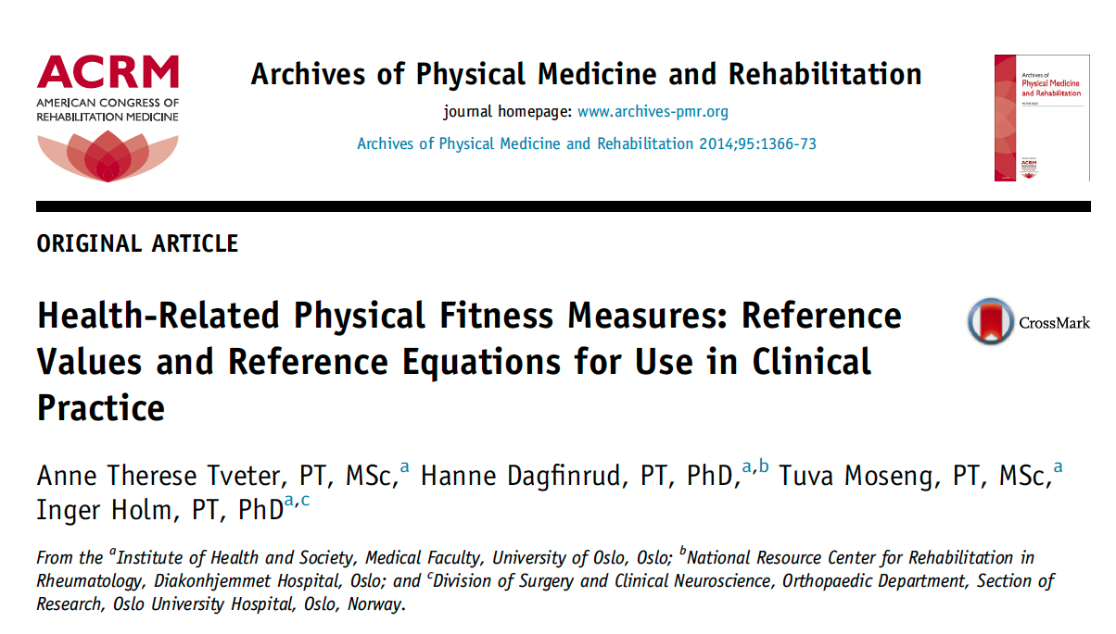
Resources
www.icucycle.com (log-in information to be sent after this meeting)

Slide 21
Thank you!
Michelle: khome@mcmaster.ca
Heather: ogradyh@mcmaster.ca

